Slide 1
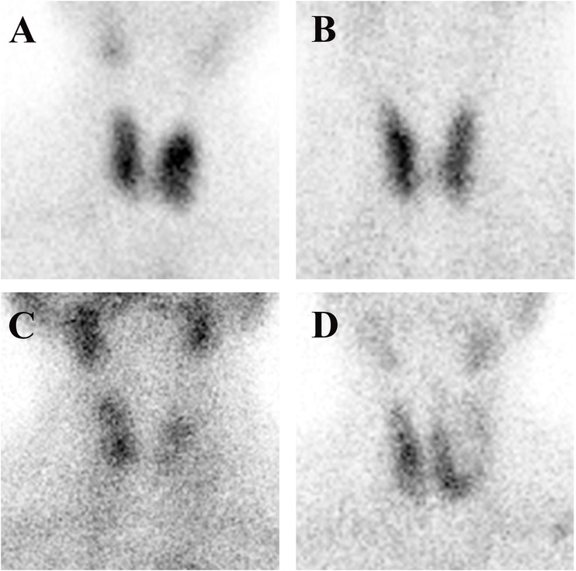


Transforming Thyroid Detection:
AI-Powered Diagnostics for Better Healthcare

Slide 2
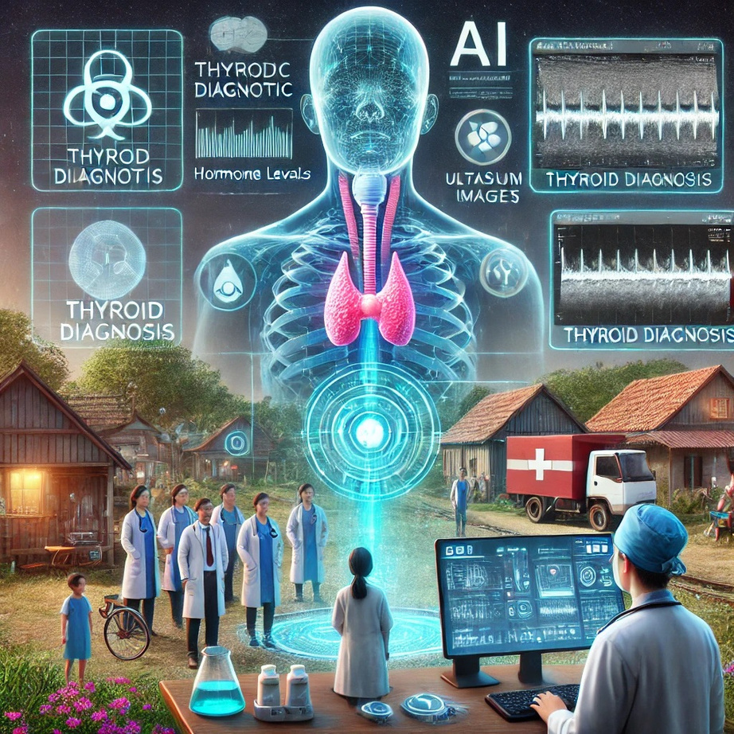
01
Use of AI in Medial Field
02
Exploring AI for Thyroid Detection
03
What Are We Aiming
04
Pipeline of The Project
05
Benifits to medical systems
06
What and why do we need ?

Slide 3
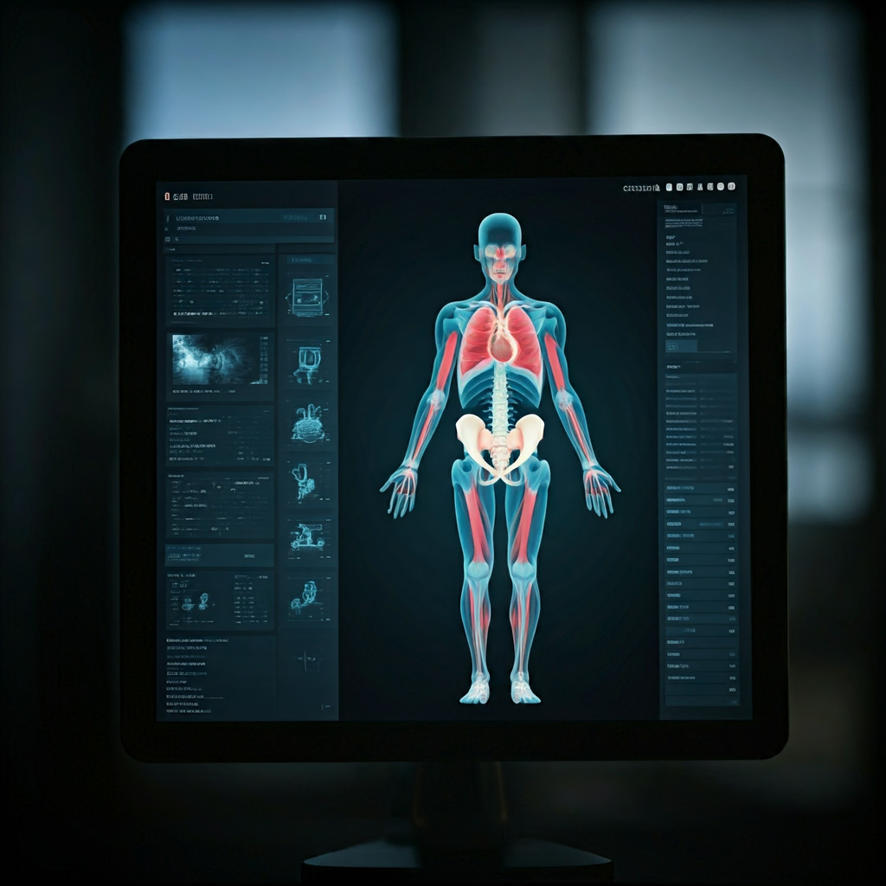
Use of AI in Medical Field
Exploring the Role of AI and Machine Learning in Disease Detection
AI algorithms analyze X-rays, MRIs, and CT scans with remarkable accuracy, often spotting anomalies that human eyes may miss.
AI enables precision treatments by analyzing genetic, environmental, and lifestyle data to customize therapies. This approach is especially effective in cancer treatment and chronic diseases.
AI-enabled diagnostic tools allow healthcare services to reach underserved populations, particularly in rural areas.
In 2023, the integration of Artificial Intelligence (AI), Machine Learning (ML), and Deep Learning (DL) into healthcare, saw a more than 23,000 articles.
Around the world, top universities and leading scientists are actively exploring how Artificial Intelligence (AI) can revolutionize the medical field. Institutions such as MIT, Stanford University, Oxford University are at the forefront of groundbreaking research, addressing challenges in diagnostics, treatment, and personalized medicine.

Slide 4
Exploring AI for Thyroid Detection
We are a team of enthusiastic Master's students in Computer Science, deeply committed to harnessing the power of Artificial Intelligence (AI) and Machine Learning (ML) to solve real-world problems. Under the guidance of Dr. Reena Kasana, a seasoned professor in Computer Science, we have chosen to focus on AI-driven thyroid detection and diagnosis.
This area remains largely underexplored in AI research, despite the significant impact thyroid disorders have on global health. With minimal existing research in this domain, we see an opportunity to innovate and create solutions that can revolutionize healthcare by improving early detection, enhancing diagnostic accuracy, and making healthcare accessible to underserved communities.
Through our work, we aim to contribute to the growing body of research in AI for healthcare by addressing the critical challenges posed by thyroid disorders. By leveraging advanced AI techniques, we intend to develop innovative solutions that are not only scientifically robust but also practical and scalable.

Slide 5
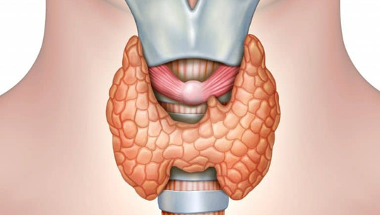
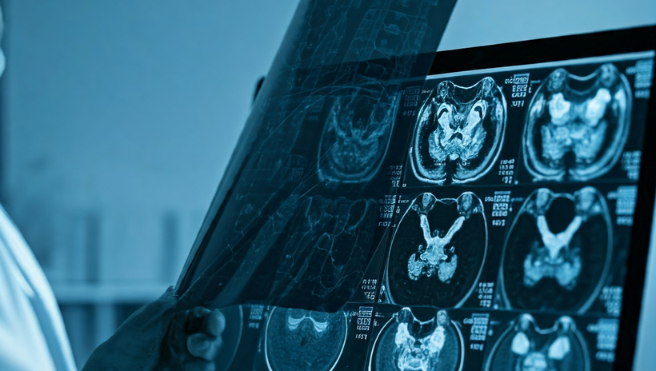
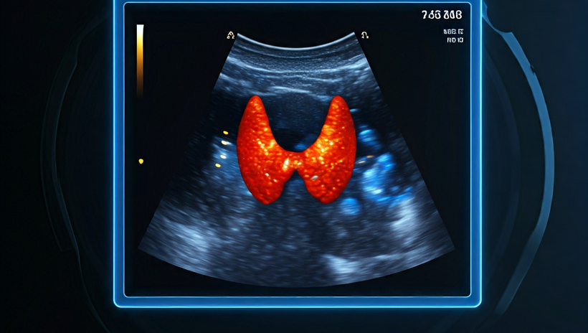
What are we Aiming
Through our work, we aim to contribute to the growing body of research in AI for healthcare by addressing the critical challenges posed by thyroid disorders. By leveraging advanced AI techniques, we intend to develop innovative solutions that are scientifically robust, practical, and scalable.
Type Identification
Diagnosis Generation
Treatment Insights
Our model aims to precisely identify the specific type of hyperthyroidism, such as Graves’ disease, toxic nodular goiter, or thyroiditis, by analyzing patterns in patient data.
Using advanced machine learning algorithms, the model will generate a comprehensive and accurate diagnosis.
Beyond diagnosis, the model will provide tailored insights to guide appropriate treatment options, ensuring patients receive targeted and effective care

Slide 6
Pipeline of The Project
Data Collection
Data Preprocessing:
Network Architecture
Training and Model Optimization
Validation and Performance Evaluation
Feature Visualization and Final Reaults
Thyroid scintigraphy images needs to be gathered and categorized into specific thyroid conditions
Images will be cleaned, and divided into training and validation sets, and other exploratory data analysis majors
Working on multiple model pipelines( RESnet, Inception v3, Transformers) need data and EDA results to further specify best suited pipeline
Feeding data to our models and finding best optimising functions( ADAM,ADGRAD) and loss-functions( Cross entorpy) while optimising for most efficient iteration count
Evaluation of Performance metrics like accuracy, sensitivity, and specificity using internal and external datasets.
: Grad-CAM heatmaps for visual insights into areas influencing the model’s decisions.

Slide 7
Benefits of the model to healthcare system
Improved Diagnosis: The model can automate the analysis of SPECT images, providing faster and more accurate classifications of hyperthyroidism types, reducing the burden on radiologists and minimizing human error.
Efficiency in Workflow: Automating repetitive tasks like image analysis allows healthcare professionals to focus on more critical aspects of patient care, improving overall efficiency and reducing wait times for diagnosis.
Enhanced Accessibility: With advancements in natural language processing (NLP), the model could be expanded to analyze patients' descriptions of symptoms in everyday language, making it easier for individuals to seek preliminary advice from the comfort of their homes.
Support for Research: The model's ability to uncover hidden patterns in medical data can help the institution advance its research capabilities, potentially discovering new correlations or early indicators of disease.

Slide 8
Benefits of the model to healthcare system
Scalability for Remote Healthcare: The system can be integrated into telemedicine platforms, enabling healthcare institutions to offer diagnostic services in remote or underserved areas without the need for specialized infrastructure or personnel on-site.
Future Integration: The model could be further developed to incorporate patient history, lab results, and symptom descriptions, creating a comprehensive tool for personalized medicine and predictive analytics.
By adopting such advanced tools, the institute positions itself as a leader in innovative, patient-centered care while paving the way for future possibilities in AI-driven healthcare.

Slide 9
What we need from you

Slide 10
We need specific data from medical institutions to train a Deep learning-based model for hyperthyroidism classification using SPECT images. Here's what we require:
1. Anonymized SPECT Images: Clear, high-quality thyroid scan images showing thyroid activity without any personal patient details.
2. Diagnostic Reports: Accompanying reports that describe the medical traits seen in the images, such as patterns or abnormalities linked to different types of hyperthyroidism (e.g., Graves' disease, thyroid cancer).
3. Focus on Traits: The data should only include details about the condition or disease traits, not any sensitive or personal information about the patients.
This type of data ensures privacy while allowing us to train the model to recognize specific traits and classify hyperthyroidism effectively.

Slide 11
Why do we need this data

Slide 12
Deep learning models work by mimicking how our brains learn from experience. They use layers of artificial "neurons" to process data step by step. The model is trained by showing it lots of examples, and with each example, it adjusts its internal settings to better recognize patterns. Over time, it gets better at identifying specific features that are important for solving the problem—like spotting signs of a disease in medical images.
In this case, our deep learning model will learn from SPECT images of the thyroid and diagnostic reports that describe traits of different hyperthyroidism conditions. By analyzing these examples, the model identifies patterns linked to each condition. Later, when we give the model a new thyroid scan, it can use the patterns it learned to predict what type of hyperthyroidism is present.
Additionally, deep learning models can detect patterns or correlations in the data that might not be obvious to humans, potentially uncovering new insights about hyperthyroidism. This capability could significantly advance medical research by improving diagnosis, treatment, and our overall understanding of the disease.

Slide 13
Project team
Dr. Reena Kasana
Vinay Dagar
Harsh Yadav
Assitant Professor
Department of Computer Science
University of Delhi
M.Sc
Computer Science
University of Delhi
M.Sc
Computer Science
University of Delhi

